Slide 1
Software Quality Assurance
/
Software Quality Engineering
Lecture 13
Naseer Ahmed

Slide 2
Software Quality
Software quality is:
1. The degree to which a system, component, or process meets specified
requirements.
2. The degree to which a system, component, or process meets customer or
user needs or expectations.

Slide 3
Software Quality
The Uniqueness Of Software Quality Assurance.
The fundamental differences between software products (including firmware) and other products are caused by the higher product complexity, by the invisibility of software and by the nature of the product development and production process.
These differences create the need for an SQA methodology and tools for SQA that will meet the special and different challenges for the development and operation of quality assurance for software.

Slide 4
Software Quality
The Environments For Which SQA Methods Were Developed.
The SQA methods and tools are specially aimed at the needs of professional software development and maintenance, activities where quality problems appear in their most severe form, and where the most painful losses are expected. Therefore any method or tool to be applied is subject to the environmental characteristics of their activities, namely:
Contract conditions and commitments defining the contents and timetable.
The conditions of the customer–supplier relationship, as realized by the need for consultation with the customer and the acquisition of his approval

Slide 5
Software Quality
The Environments For Which SQA Methods Were Developed.
Teamwork requirements.
Need for cooperation and coordination with other software and hardware development teams both internally and externally.
Need for interfaces with other software systems.
Need to continue carrying out a project when team members change.
Need to conduct maintenance of the software system for several years.

Slide 6
Software Quality Assurance Vs. Software Quality Control
Quality Control:
Quality control is defined as “a set of activities designed to evaluate the quality of a developed or manufactured product” (IEEE, 1991); in other words, activities whose main objective is the withholding of any product that does not qualify. Accordingly, quality control inspection and other activities take place as the development or manufacturing of the product is completed yet before the product is shipped to the client.

Slide 7
Software Quality Assurance Vs. Software Quality Control
Quality assurance:
The main objective of quality assurance is to minimize the cost of guaranteeing quality by a variety of activities performed throughout the development and manufacturing processes/stages. These activities prevent the causes of errors, and detect and correct them early in the development process. As a result, quality assurance activities substantially reduce the rate of products that do not qualify for shipment and, at the same time, reduce the costs of guaranteeing quality in most cases.
In sum:
(1) Quality control and quality assurance activities serve different objectives.
(2) Quality control activities are only a part of the total range of quality assurance activities.

Slide 8
The Objectives Of SQA Activities:
Software development (process-oriented):
Assuring an acceptable level of confidence that the software will conform to functional technical requirements.
2. Assuring an acceptable level of confidence that the software will conform to managerial scheduling and budgetary requirements.
3. Initiating and managing of activities for the improvement and greater efficiency of software development and SQA activities. This means improving the prospects that the functional and managerial requirements will be achieved while reducing the costs of carrying out the software development and SQA activities.

Slide 9
The Objectives Of SQA Activities:
Software maintenance (product-oriented):
1. Assuring with an acceptable level of confidence that the software
maintenance activities will conform to the functional technical requirements.
2. Assuring with an acceptable level of confidence that the software
maintenance activities will conform to managerial scheduling and
budgetary requirements.
3. Initiating and managing activities to improve and increase the efficiency of software maintenance and SQA activities. This involves improving the prospects of achieving functional and managerial requirements while reducing costs.

Slide 10
Software Quality Factors
Classifications Of Software Requirements Into Software
Quality Factors:
Several models of software quality factors and their categorization in factor categories
McCall’s factor model
Evans and Marciniak
Deutsch and Willis

Slide 11
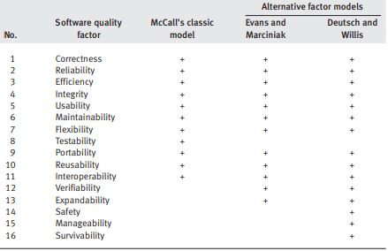
Software Quality Factors
Classifications Of Software Requirements Into Software
Quality Factors:

Slide 12
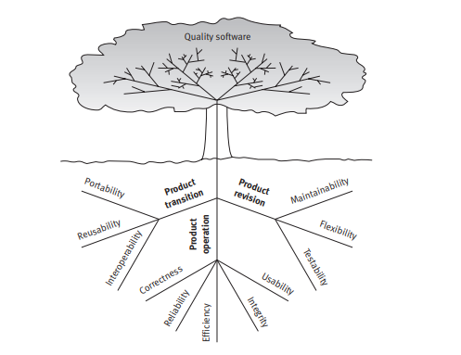
Software Quality Factors
Classifications Of Software Requirements Into Software
Quality Factors:

Slide 13
Software Quality Factors
Those Interested In Defining Software Quality Requirements.
The client is not the only party interested in thoroughly defining the requirements that assure the quality of the software product. The developer is often interested in adding requirements that represent his own interests, such as reusability, verifiability and portability requirements. These may not, however, be of interest to the
client. Thus, one can expect that a project will be carried out according to two
requirements documents:
■ The client’s requirements document
■ The developer’s additional requirements document

Slide 14
Components Of SQA System
An SQA system always combines a wide range of SQA components, all of which are employed to challenge the multitude of sources of software errors and to achieve an acceptable level of software quality.
Pre-project components. To assure that
the project commitments have been adequately defined considering the resources required, the schedule and budget.
(b) the development and quality plans have been correctly determined.

Slide 15
Components Of SQA System
Components of project life cycle activities assessment. The project life cycle is composed of two stages:
The development life cycle stage and
The operation–maintenance stage.
The development life cycle stage components detect design and programming errors.
The SQA components used during the operation–maintenance phase include specialized maintenance components as well as development life cycle components, which are applied mainly for functionality improving maintenance tasks.

Slide 16
Components Of SQA System
Components of project life cycle activities assessment.
The project life cycle is composed of two stages:
The development life cycle stage and
The operation–maintenance stage.
The development life cycle stage components detect design and programming errors.
The SQA components used during the operation–maintenance phase include specialized maintenance components as well as development life cycle components, which are applied mainly for functionality improving maintenance tasks.

Slide 17
Components Of SQA System
Components of infrastructure error prevention and improvement. The main objectives of these components, which are applied throughout the entire organization, are to eliminate or at least reduce the rate of errors, based on the organization’s accumulated SQA experience.
Components of software quality management.
This class of components is geared toward several goals, the major ones being the control of development and maintenance activities and the introduction of early managerial support actions that mainly prevent or minimize schedule and budget failures and their outcomes.

Slide 18
Components Of SQA System
Components of standardization, certification, and SQA system assessment.
These components implement international professional and
managerial standards within the organization. The main objectives of this class are
utilization of international professional knowledge,
(b) improvement of coordination of the organizational quality systems with other organizations, and
(c) assessment of the achievements of quality systems according to a common scale.
The various standards may be classified into two main groups:
quality management standards, and
(b) project process standards

Slide 19
Components Of SQA System
Organizing for SQA – the human components.
The SQA organizational base includes managers, testing personnel, the SQA unit and practitioners interested in software quality (SQA trustees, SQA committee members and SQA forum members). All these actors contribute to software quality; their main objectives are to initiate and support the implementation of SQA components, detect deviations from SQA procedures and methodology, and suggest improvements

Slide 20
Software Quality Costs
The quality costs incurred by software development and application are, according to the
extended quality costs model,
the costs of control (prevention costs,
appraisal costs,
and managerial preparation and control costs)
combined with the costs of failure (internal failure costs, external failure costs, and managerial failure costs).
Management is especially interested in the total sum of the quality costs. It is believed that up to a certain level, expanding the resources allocated to control activities yields much larger savings in failure costs while reducing total quality costs.

Slide 21
SQA standards, system certification, and assessment components
External tools offer another avenue for achieving the goals of software quality assurance. Specifically, the main objectives of this class of components are:
(1) Utilization of international professional knowledge.
(2) Improvement of coordination with other organizations’ quality systems.
(3) Objective professional evaluation and measurement of the achievements
of the organization’s quality systems.

Slide 22
SQA standards, system certification, and assessment components
Quality management standards:
The organization can clearly benefit from quality standards of the second sub-class that guide the management of software development, maintenance, and infrastructure. These standards focus on what is required and leave the decision about how to achieve it to the organization. The application of a managerial quality system provides a fairly objective assessment of the organization's achievements. Organizations that comply with quality achievement requirements can then seek SQA certification. The most familiar examples of this type of standard are:
■ SEI CMM assessment standard
■ ISO 9001 and ISO 9000-3 standards.
4.6.2 Project process standards

Slide 23
SQA standards, system certification, and assessment components
Project process standards
Project process standards are professional standards that provide methodological guidelines (dealing with the question of “how”) for the development team. Well-known examples of this type of standards are:
■ IEEE 1012 standard
■ ISO/IEC 12207 standard.

Slide 24
Software development risks and software risk management
Software development risks
Several lists of potential software development risks
(1) Scheduling and timing risks
(2) System functionality risks
(3) Subcontracting risks
(4) Requirement management risks
(5) Resource usage and performance risks
(6) Personnel management risks.

Slide 25
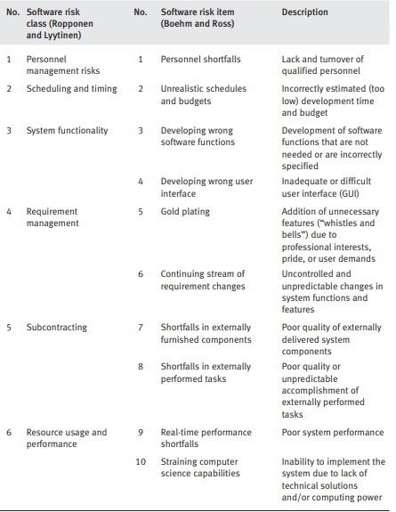
Software development risks and software risk management

Slide 26
Software development risks and software risk management
Risk management activities and measures
Various activities and measures (usually termed “risk management actions” or RMAs) can be taken. The purposes of RMAs are to prevent software risks, to achieve early identification of software risk items, and to resolve them

Slide 27
The risk management process
The risk management process combines
planning activities,
Implementation activities and
monitoring activities
Planning activities
Several planning activities are aimed to initiate those risk management actions that can respond to the software risks identified and evaluated earlier. Similar planning activities (although not to the same degree of thoroughness) are part of the proposal draft review process
Identification of software risk items
Evaluation of the identified SRIs

Slide 28
The risk management process
Planning RMAs
It is incumbent upon the software risk team to consider alternative ways to resolve the identified SRIs. RMAs include a range of internal, subcontractor and customer actions. RMAs and their contributions to the prevention or resolution of SRIs.
In preparing the recommended list of RMAs, the planning team
should consider:
– The priority assigned to the SRI
– The expected results of a planned RMA (complete or partial resolution)
– The costs and organizational efforts required for implementation of the RMA

Slide 29
The risk management process
Implementation
Implementation of a risk management plan requires that the staff members be assigned personally responsible for each RMA and its implementation schedule.
Monitoring implementation of the risk management plan
Systematic, periodic activities are required to monitor implementation of the risk management plan. The aim of the monitoring activities is to:
■ Determine the efficiency of the RMAs
■ Update the risk evaluation by considering newly identified SRIs

Slide 30
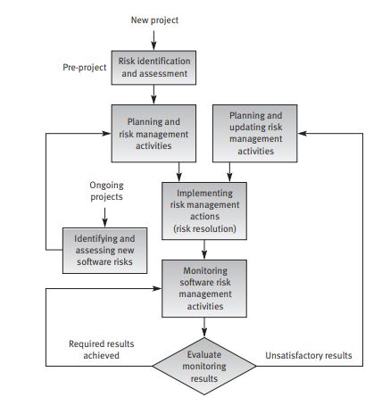
The risk management process

Slide 31
Integrating quality activities in the project life cycle
Most quality assurance activities take place in conjunction with the completion or examination of activity milestones, which require review of the product development activities previously completed. Therefore, SQA professionals should be acquainted with the various software engineering models in order to be able to prepare a quality plan that is properly integrated into the project plan.
Classic and other software development methodologies
Four models of the software development process are discussed in this section:
■ The Software Development Life Cycle (SDLC) model
■ The prototyping model
■ The spiral model
■ The object-oriented model

Slide 32
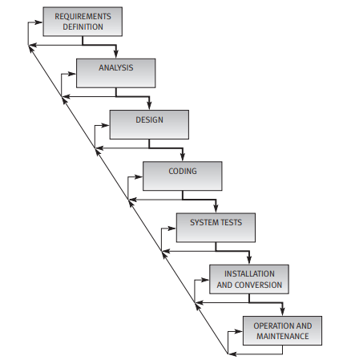
Integrating quality activities in the project life cycle
The Software Development Life Cycle model (the SDLC model) is the
classic model The model displays the major building blocks for the entire development process, described as a linear sequence.

Slide 33
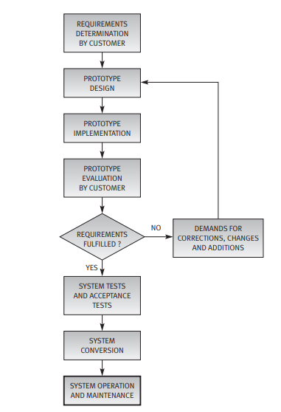
Integrating quality activities in the project life cycle
The prototyping model is based on
replacement of one or more
SDLC model phases by an
evolutionary process, where
software prototypes are used
for communication between
the developer and the users
and customers.

Slide 34
Integrating quality activities in the project life cycle
The spiral model, as revised by Boehm (1988, 1998), offers an improved methodology for overseeing large and more complex development projects displaying higher prospects for failure, typical of many projects begun in the last two decades.
According to the spiral model, software development is perceived to be an iterative process; at each iteration, the following
activities are performed:
■ Planning
■ Risk analysis and resolution
■ Engineering activities according to the stage of the project: design, coding, testing, installation and release
■ Customer evaluation, including comments, changes and additional requirements, etc.

Slide 35
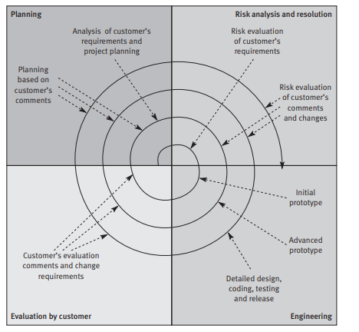
Integrating quality activities in the project life cycle
The spiral model

Slide 36
Integrating quality activities in the project life cycle
The object-oriented model differs from the other models by its intensive reuse of software components. This methodology is characterized by its easy integration of existing software modules (called objects or components) into newly developed software systems. A software component library serves this purpose by supplying software components for reuse.

Slide 37
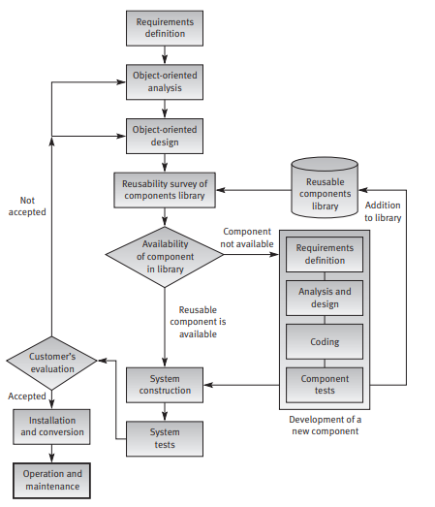
Integrating Quality Activities In The Project Life Cycle
The object-oriented model

Slide 38
Integrating Quality Activities In The Project Life Cycle
Factors affecting the required intensity of quality assurance activities
Project factors:
■ Magnitude of the project
■ Technical complexity and difficulty
■ Extent of reusable software components
■ Severity of failure outcomes if the project fails

Slide 39
Integrating Quality Activities In The Project Life Cycle
Factors affecting the required intensity of quality assurance activities
Team factors:
■ Professional qualification of the team members
■ Team acquaintance with the project and its experience in the area
■ Availability of staff members who can professionally support the team
■ Familiarity with the team members, in other words the percentage of new
staff members in the team

Slide 40
Quality Of Software Maintenance Components
The following three components of maintenance service are all essential for success:
■ Corrective maintenance – user support services and software corrections.
■ Adaptive maintenance – adapts the software package to differences in new customer requirements, changing environmental conditions and the like.
■ Functionality improvement maintenance – combines (1) perfective maintenance of new functions added to the software so as to enhance performance,
with (2) preventive maintenance activities that improve reliability and system infrastructure for easier and more efficient future maintainability

Slide 41
Quality Of Software Maintenance Components
Software maintenance QA activities: objectives
1. Assure, with an accepted level of confidence, that the software
maintenance activities conform to the functional technical requirements.
2. Assure, with an accepted level of confidence, that the software maintenance activities conform to managerial scheduling and budgetary requirements.
3. Initiate and manage activities to improve and increase the efficiency of software maintenance and SQA activities. This involves improving the prospects of achieving functional and managerial requirements while reducing costs.

Slide 42
Corrective And Preventive Actions
Corrective Actions: A regularly applied feedback process that includes collection of information on quality non-conformities, identification and analysis of sources of irregularities as well as development and assimilation of improved practices and procedures, together with control of their implementation and measurement of their outcomes.
Preventive Actions: A regularly applied feedback process that includes collection of information on potential quality problems, identification and analysis of departures from quality standards, development and assimilation of improved practices and procedures, together with control of their implementation and measurement of their outcomes.

Slide 43
Corrective And Preventive Actions
Successful operation of a CAPA process includes the following activities:
■ Information collection
■ Analysis of information
■ Development of solutions and improved methods
■ Implementation of improved methods
■ Follow-up.

Slide 44
Corrective And Preventive Actions
There are four main information source types that support and feed CAPA processes:
■ Software development process
■ Software maintenance
■ SQA infrastructure procedures
■ Software quality management procedures.

Slide 45
Corrective And Preventive Actions
Five approaches for introduction of CAPA are commonly used:
■ Updating relevant procedures.
■ Changing software development or maintenance practices and updating work instructions.
■ Changing current to more effective software development tools that are less prone to faults.
■ Improving reporting methods by revising task content and reporting frequencies. This approach is meant to achieve earlier detection of faults and thus reduce damages.
■ Initiating training, retraining and updating of staff.

Slide 46
Documentation Control
The main objectives for managing controlled documents are:
■ To assure the quality of the document.
■ To assure the document’s technical completeness, compliance with approved document structure and use instructions (use of templates, proper signing, etc.).
■ To assure future availability of documents that may be required for maintenance, further development of the software system or responding to the customer’s complaints.
■ To support investigation of software failure causes and to assign responsibility as part of corrective and other actions

Slide 47
Software Quality Metrics
A quantitative measure of the degree to which an item possesses a given quality attribute.
A function whose inputs are software data and whose output is a single numerical value that can be interpreted as the degree to which the software possesses a given quality attribute

Slide 48
Software Quality Metrics
Software quality metrics are implemented:
■ To support control of software development projects and software maintenance contracts. Their aim is to provide management with information regarding:
– Compliance with functional (quality) performance requirements
– Compliance with project timetable and budget.
■ To deliver the metrics accumulated and analyzed by the CAB. Use of these metrics data is aimed at enabling preventive and corrective actions throughout the organization

Slide 49
Software Quality Metrics
Objective of Software quality metrics
Software quality metrics are implemented:
■ To support control of software development projects and software maintenance contracts. Their aim is to provide management with information regarding:
– Compliance with functional (quality) performance requirements
– Compliance with project timetable and budget.
■ To deliver the metrics accumulated and analyzed by the CAB. Use of these metrics data is aimed at enabling preventive and corrective actions throughout the organization

Slide 50
Software Quality Metrics
Requirements For Successful Software Quality Metrics.
Applicability of quality metrics is determined by the degree to which the following general and operative requirements are fulfilled:
General requirements
■ Relevant – measures an attribute of considerable importance
■ Valid – measures the required attribute
■ Reliable – produces similar results when applied in similar conditions
■ Comprehensive – applicable to a large variety of situations
■ Mutually exclusive – does not measure attributes already measured by other metrics.

Slide 51
Software Quality Metrics
Requirements For Successful Software Quality Metrics.
Operative requirements
■ Easy and simple – data collection is implemented with minimal resources
■ Does not require independent data collection – metrics data collection is based on currently employed data collection systems, e.g. employee attendance records, cost accounting methods
■ Immune to biased interventions by interested parties (team members and others)

Slide 52
Software Quality Metrics
Categories of Software Quality Metrics
A two-level system of categories is used here. The first level distinguishes between
two categories:
■ Process metrics, related to the software development process
■ Product metrics, related to software maintenance.
Each first-level category is broken down into one of three sub-categories :
■ Software process quality metrics
■ Software process timetable metrics
■ Software process productivity metrics.

Slide 53
Software Quality Metrics
Categories of Software Quality Metrics
The software product metrics are classified into four HD and corrective maintenance
sub-categories:
■ HD quality metrics
■ HD productivity and effectiveness metrics
■ Software corrective maintenance quality metrics
■ Software corrective maintenance productivity and effectiveness metrics

